Slide 1
Layout Analysis and Reconstruction
jan.schulz@devugees.org

Slide 2
Agenda
Google
Bing
Twitter
YouTube

Slide 3
Feedback Assignment
First Group
Started colouring + effecting the elements first
Second Group
Started positioning + aligning the elements first

Slide 4
Feedback Assignment
First Group
Started colouring + effecting the elements first
Second Group
Started positioning + aligning the elements first
Second Group has the better approach!
Divide & Conquer!

Slide 5
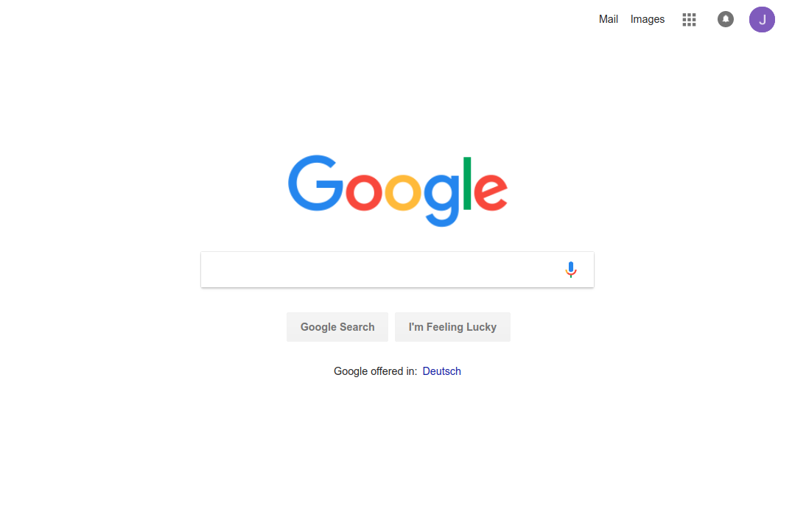
1. Google - Mobile

Slide 6
1. Google - Mobile
HEADER
NAVIGATION
MAIN
LOGO
SEARCH BOX
SEARCH BTN
LUCYK BTN
IMPRINT

Slide 7
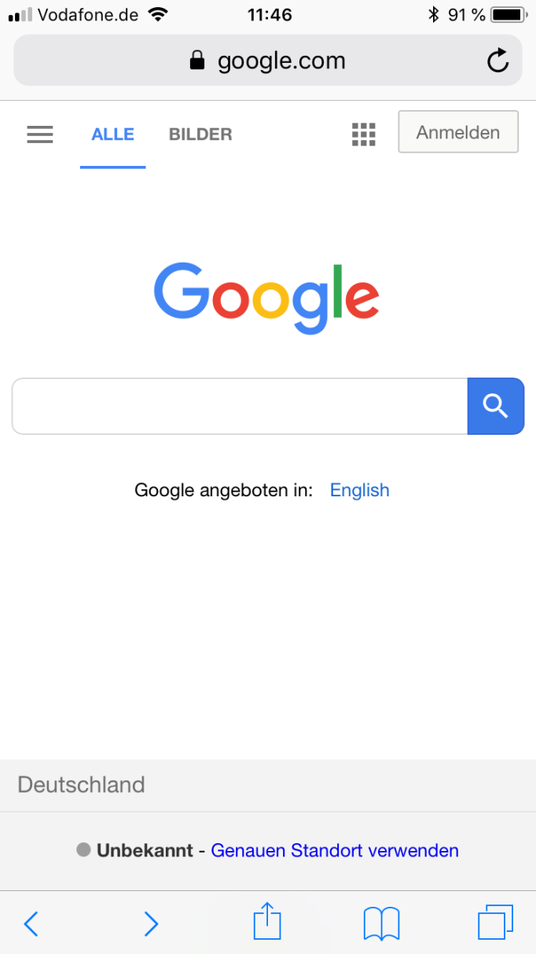
1. Google - Desktop

Slide 8
1. Google - Desktop
MAIN
NAVIGATION
LOGO
SEARCH BOX
B
IMPRINT
LOCATION

Slide 9
Task:
Analyze the following websites using Chrome Devtools and your abstraction skills!
Take a pencil and a sheet of paper and illustrate a graphical concept of the fundamental parts of each website!

Slide 10
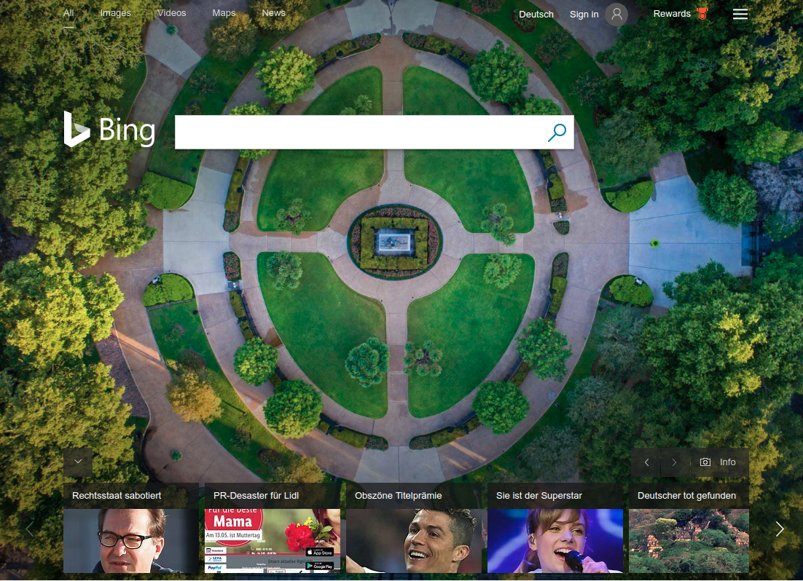
2. Bing

Slide 11
2. Bing
HEADER
NAVIGATION 1
NAVIGATION 2
MAIN
LOGO
SEARCH BOX
B
NEWS THUMBNAILS

Slide 12
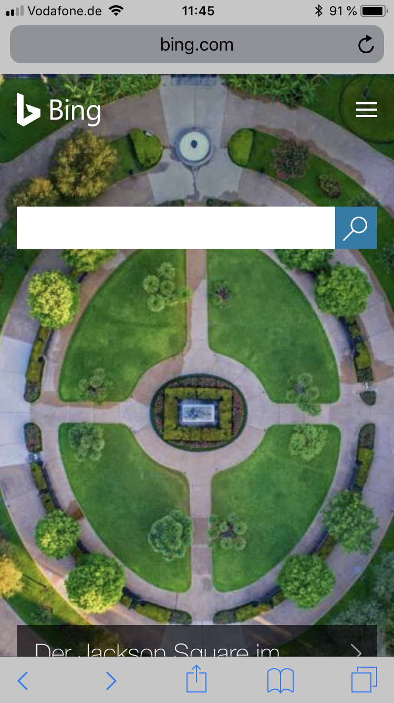
2. Bing

Slide 13
2. Bing
MAIN
LOGO
N
SEARCH BOX
B

Slide 14
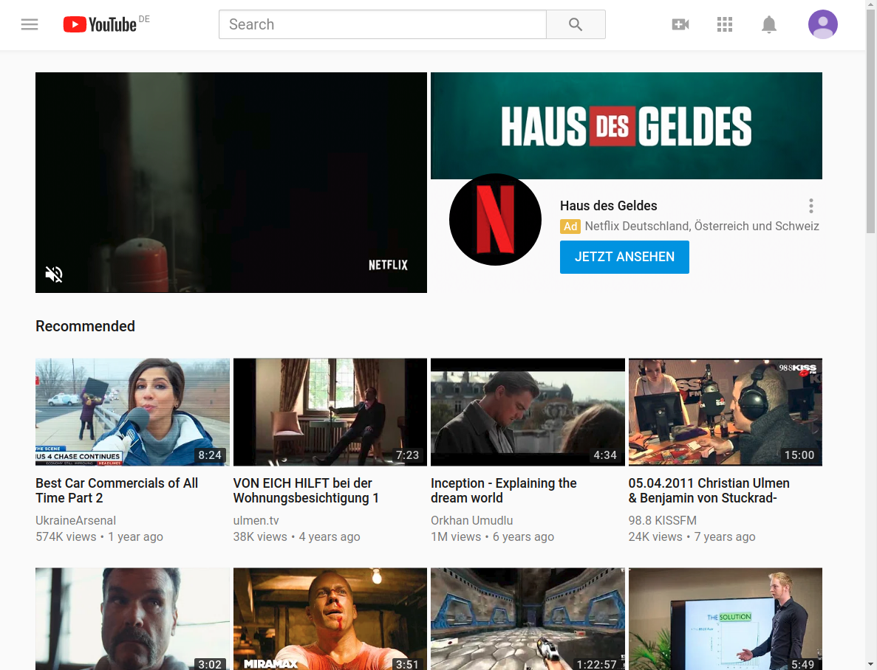
3. YouTube

Slide 15
3. YouTube
LOGO
SEARCHBOX
S
NAVIGATION
TEASER
AD
THUMBNAIL
THUMBNAIL
THUMBNAIL
THUMBNAIL
THUMBNAIL
THUMBNAIL
THUMBNAIL
THUMBNAIL

Slide 16
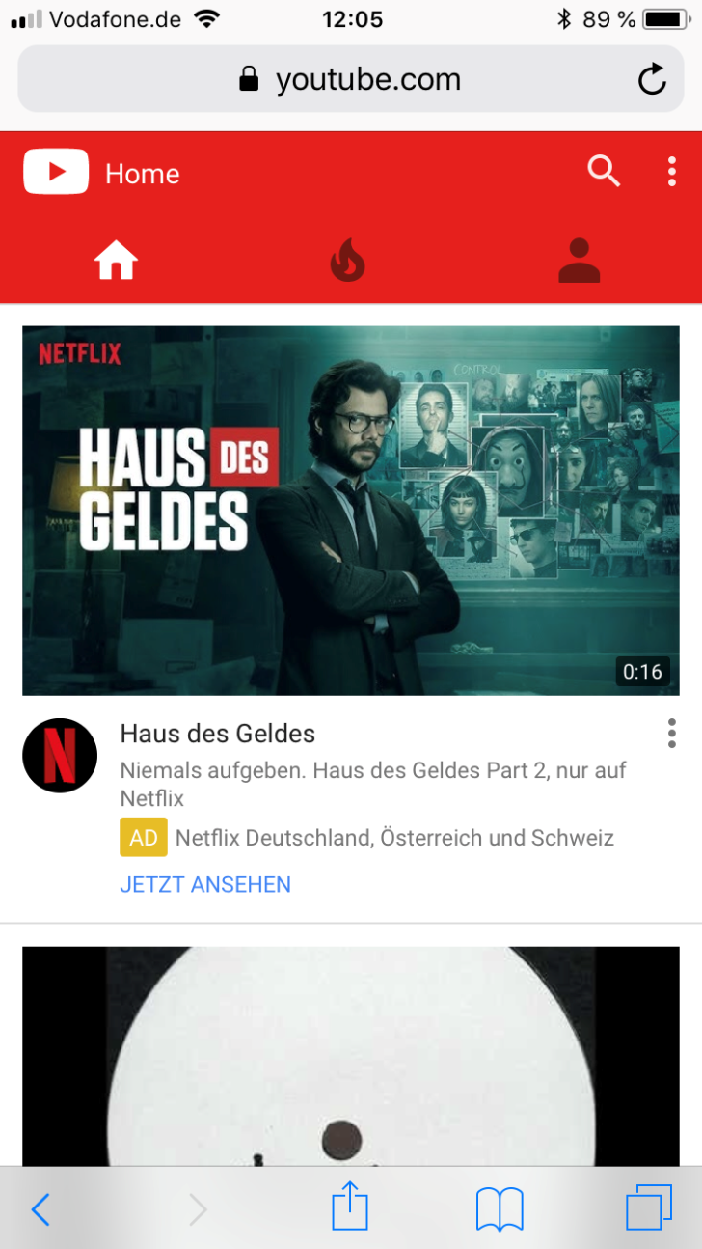
3. YouTube

Slide 17
3. YouTube
L
NAVIGATION 1
NAVIGATION 2
AD
TEASER
THUMBNAIL

Slide 18
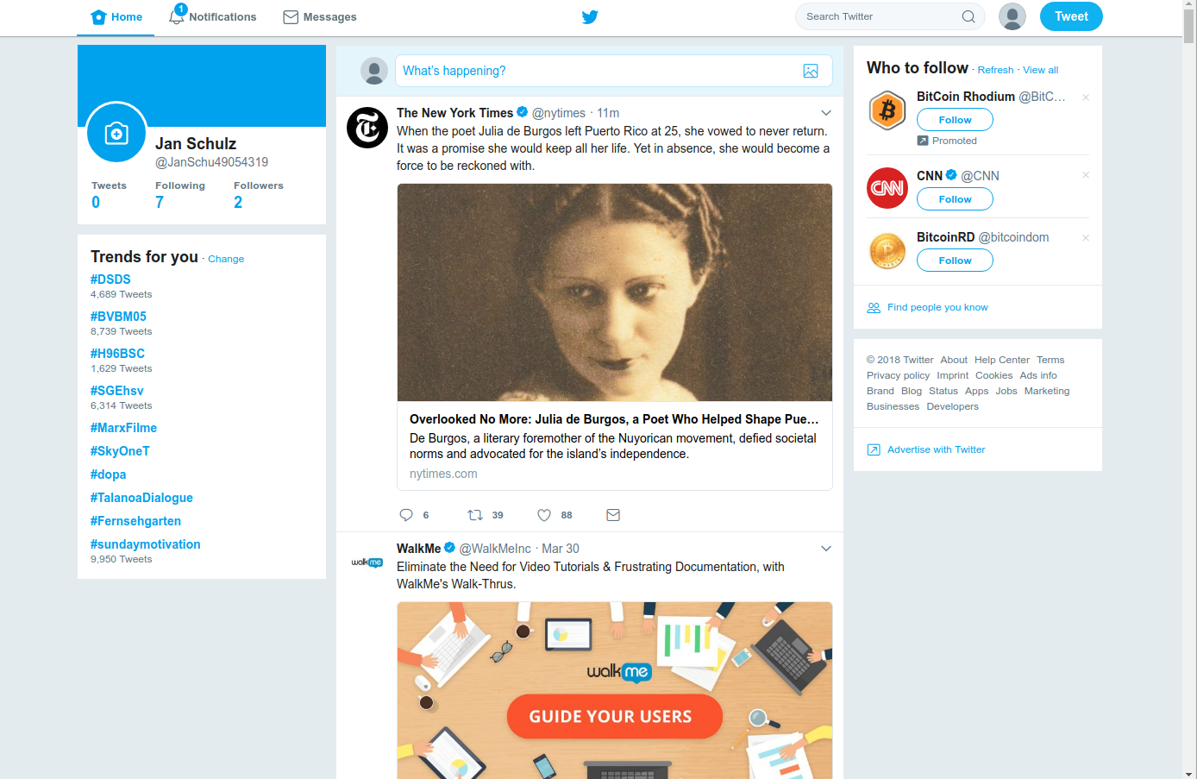
4. Twitter

Slide 19
4. Twitter
HEADER
NAVIGATION
SEARCHBOX
LEFT
SIDEBAR
RIGHT
SIDEBAR
SEARCH BOX
RIGHT
SIDEBAR
ARTICLE
ARTICLE

Slide 20
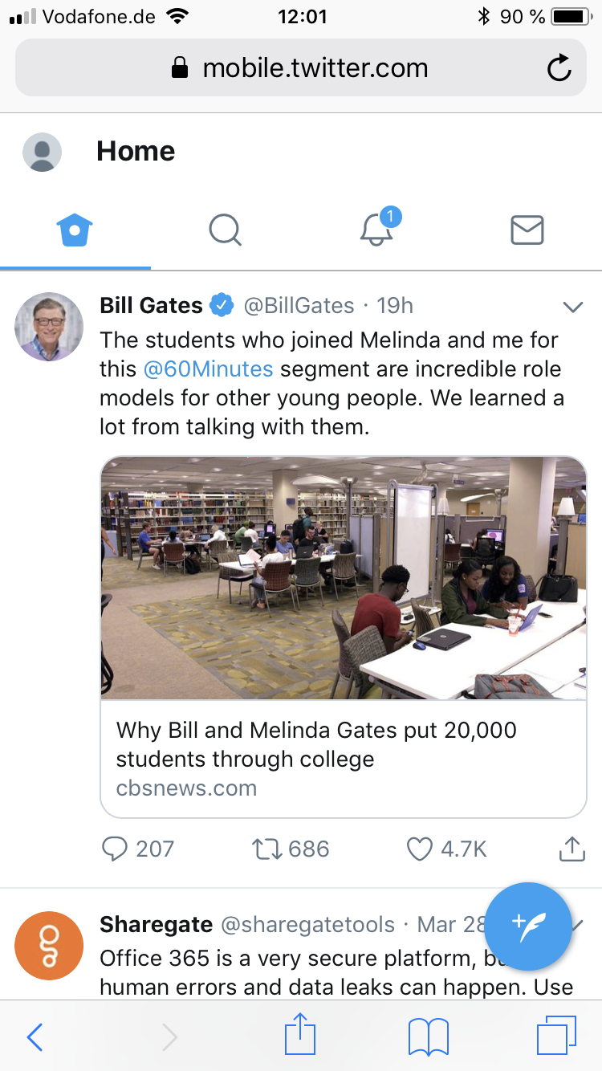
4. Twitter

Slide 21
4. Twitter
LEFT
SIDEBAR
NAVIGATION 1
NAVIGATION 2
ARTICLE
ARTICLE

Slide 22
Task
Implement your concepts as HTML/SCSS layouts!

